Slide 1
Transitioning to Scrum-Agile at ChadaTech
Reginald Cooper
6/20/2024

Slide 2
Agile Roles
Product Owner: Defines features, prioritizes backlog
Scrum Master: Facilitates Scrum process, removes impediments
Development Team: Develops product, self-organizes

Slide 3

Agile Phases
Planning: Define sprint goals and tasks
Development: Build and test features
Testing: Validate functionality
Review: Demonstrate and gather feedback
Retrospective: Reflect and improve

Slide 4
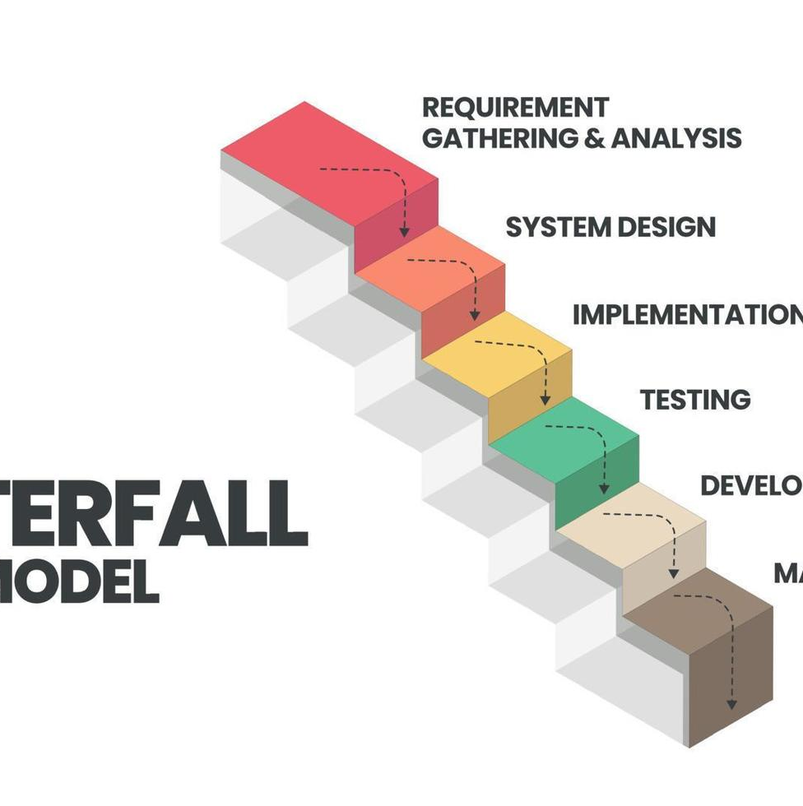
Describing Waterfall Model
Sequential phases: Requirements, Design, Implementation, Verification, Maintenance
Less flexible, difficult to handle changes
Example: Changes in requirements late in the project are costly and disruptive

Slide 5
Waterfall or Agile Approach
Factors to consider:
Project size and complexity
Flexibility and ability to adapt to changes
Team collaboration and communication
Client involvement and feedback

Slide 6
References
Beck, K., Beedle, M., van Bennekum, A., Cockburn, A., Cunningham, W., Fowler, M., ... & Thomas, D. (2001). Manifesto for Agile Software Development. Retrieved from https://agilemanifesto.org/
Cohn, M. (2010). Succeeding with Agile: Software Development Using Scrum. Addison-Wesley Professional.
Schwaber, K., & Sutherland, J. (2020). The Scrum Guide: The Definitive Guide to Scrum: The Rules of the Game. Retrieved from https://www.scrumguides.org/
Sommerville, I. (2015). Software Engineering (10th ed.). Pearson.

Slide 7
Thank You
Reginald Cooper
Email:reginald.cooper@snhu.edu
Developer at ChadaTech

